Slide 1


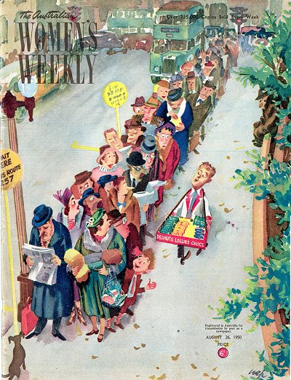
Computer Networks Performance Evaluation

Slide 2
Chapter 13
Queuing Models with Multiple Classes
Performance by Design:
Computer Capacity Planning by Example
Daniel A. Menascé, Virgilio A.F. Almeida, Lawrence W. Dowdy
Prentice Hall, 2004

Slide 3

Chapter 12-Outlines
13.1 Introduction
13.2 The Need for Multiple-Class Models
13.3 Simple Two-Class Model
13.4 Notation and Assumptions
13.5 Closed Models
13.6 Open Models
13.7 Mixed Models
13.8 Concluding Remarks
13.9 Exercises

Slide 4
Introduction
Real-life systems experience a wide variety of customers (heavy users, novices, web surfers, e-mail users, bank transactions) with different resource usage profiles.
Actual workloads do not tend to be a single class of homogeneous customers.
Each customer differs from every other customer.

Slide 5
Introduction’
Customers are grouped into classes of similar behaviors, which are represented in the model as the average behavior and customer population of the class.
Techniques are needed that solve multiple-class performance models.
This chapter provides MVA-based algorithms for solving open and closed product-form queuing network models with multiple classes.

Slide 6
Chapter 13-Outlines
13.1 Introduction
13.2 The Need for Multiple-Class Models
13.3 Simple Two-Class Model
13.4 Notation and Assumptions
13.5 Closed Models
13.6 Open Models
13.7 Mixed Models
13.8 Concluding Remarks
13.9 Exercises

Slide 7
The Need for Multiple-Class Models
There are various motivations for constructing multiple-class models to capture the features of heterogeneous workloads.
These models can be used to represent different QoS and SLA requirements for the different workload classes.

Slide 8
The Need for Multiple-Class Models’
The choice of the workload abstraction and the corresponding number of classes are key steps in performance modeling. For example, different Service Level Agreements (SLA) are usually imposed on different workload classes [14].
An SLA for one workload class could state that 90% of all messages to local users get delivered to the target mailbox within 60 sec.

Slide 9
Accuracy of Model
The accuracy of the system model is strongly influenced by the number of workload classes chosen.
Too few classes can lead to inaccurate generalizations whereas too many classes lead to excessive detail and complexity.

Slide 10
Single and Multiple-Calss
Single-class models are effective in capturing global behavior but are limited in their predictive capability of individual group behavior.
Although multiple-class models are more useful for describing workloads of real systems, it is difficult to obtain parameters (multiclass service demands and multiclass visit ratios) for models with multiple classes.
Inferences have to be made to parameterize each workload class and to apportion the system overhead among the classes.

Slide 11
Example 13.1
An explicit SLA defines the expectations between application clients and service providers.
Some customers require very short response time for critical applications and are willing to pay more for these specific transactions.

Slide 12
Example 13.1’
Suppose that the manager of a data center service provider is negotiating an SLA with a client representing a financial company for three types of applications:
  risk portfolio analysis,
  purchase transactions, and
  browsing transactions.
Before agreeing to the SLA, the data center manager needs to know whether the currently installed capacity can accommodate the proposed new services for the financial company client.

Slide 13
Example 13.1’’
This is an important step of the process because the SLA may also specify financial penalties if the response times are not met.
How should the data center's performance analyst specify the workload?
  A single-class workload description does not provide adequate detail for analyzing the SLA.

Slide 14
Example 13.1’’’
Instead, the performance analyst specifies a multiple-class workload model as follows :
Class 1: The risk portfolio analysis is modeled by a closed class, consisting of a set of background processes, defined by the service demands (i.e., processor and disks) and the number of processes in execution during "the peak hour."
Class 2: The online purchase transactions are modeled by an open class, defined by the service demands (i.e., processor and disks) and the average arrival rate during "a peak minute.“

Slide 15
Example 13.1’’’’
Class 3: The browsing transactions are modeled by an open class, defined by service demands (i.e., processor and disks) and an average arrival rate during "a peak minute.“
Based on the predicted response times, the data center manager will know if the currently installed capacity is sufficient for the contract. If not, the data center will have to increase its capacity before agreeing to the SLA contract.

Slide 16
Chapter 13-Outlines
13.1 Introduction
13.2 The Need for Multiple-Class Models
13.3 Simple Two-Class Model
13.4 Notation and Assumptions
13.5 Closed Models
13.6 Open Models
13.7 Mixed Models
13.8 Concluding Remarks
13.9 Exercises

Slide 17
Server Example
Consider a transaction processing server with a single processor and two disks.
The system load consists of two types of transactions:
  queries and
  updates.

Slide 18
Workload
During peak hours,
  system is under heavy load ,and
  4 transactions are in execution almost all the time.
If more than 4 transactions are allowed to execute concurrently, the system is susceptible to thrashing due to limited memory, disk, and processing capacity.

Slide 19
Monitoring Results
After monitoring the system for a given period of time, the system administrator observes that the most common execution mix during the peak hours is a combination of
  3 query transactions and
  1 update transaction.
The goal is improving system performance by investigating different system scenarios.

Slide 20
Model Choice-Open
Because of the workload type (transaction), it is natural to represent the system as an open model with a maximum number of 4 concurrent transactions.
  To avoid thrashing it is necessary to represent the effects of blocking, which makes the model non product-form (much difficult to solve analytically).

Slide 21
Model Choice-Close
An alternative view is that of a closed model with a constant number of 4 transactions in execution.
The drawback is that the model represents only the time a transaction spends in execution.

Slide 22
Influential Factors
The choice between the open and closed representations for modeling a system is influenced by several factors, including
  the difficulty in solving the model and
  the difficulty in obtaining the parameters required by each type of model.

Slide 23
Open vs Closed
An open model includes the parameterization of blocking queues to represent more realistic behavior and solving it is more complex.
A closed model is more approximate, but easier to solve since it requires only one additional parameter, the average number of transactions in execution.

Slide 24
Resource Demands
Update transactions impose significant write traffic to the disks,
Query transactions can often be satisfied by the cache and impose less load on the disks.
The model assumes that update transactions demand more resources than query transactions.

Slide 25
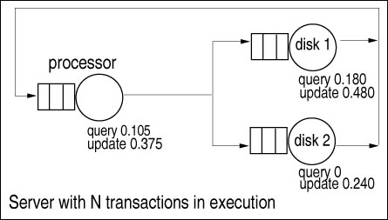
QN Model
Thus, the analyst represents the system as a two-class model, as illustrated in Figure 13.1.
Resource demands by each class (query and update) at each device are shown.
Figure 13.1. Two-class queuing model.

Slide 26
Measurement Data
The transaction processing server is monitored for 30 minutes and the measurement data shown in Table 13.1 is collected. From Table 13.1, the two classes are characterized by different service demands.
In this example, the service demands show that an update transaction performs many more I/O operations than does a query transaction (updates require more visits to the disks).
Table 13.1. Measurement Data for the Transaction Processing System
Service Demand (sec)
Class Processor Disk 1 Disk 2 Transactions in the System Transactions Completed
Query 0.105 0.180 0.000 3 7368
Update 0.375 0.480 0.240 1 736

Slide 27
Scheduling
In multiclass models, customers of different classes are often treated differently;
  writers may be given priority over readers at the disk to ensure the most up-to-date information available).
Therefore, the issue of scheduling is relevant in multiclass models.

Slide 28
Goal of Scheduling
Suppose that at a given instant of time, the 4 example transactions are contending for processor time.
Which transaction (query or update) should be serviced next?
The goal of a scheduling policy is to assign customers to be executed by a server to optimize some system objective, such as
  minimizing average response time or maximizing average throughput, or
  satisfying an SLA commitment.

Slide 29
Performance Dependencies
Modern operating systems implement various scheduling disciplines (FCFS , RR, SJN, SRT, ED, SSTF,……) .
In short, the performance of a multiclass model depends on both the service demands per class and on the scheduling policies of each device.
Making use of methods learned so far, a first approach to solving a multiclass model is to construct an equivalent single-class model.

Slide 30
Single Class Approach
To do this, it is necessary to aggregate the performance parameters of the multiple classes into a single class.
The service demand of the aggregate class at any server is
  the average of the individual class demands weighted by the relative class throughputs.
The number of transactions of the aggregate class is
  the sum of the number of transactions in the system due to each individual class.

Slide 31
Demands Aggregation
If the measured throughputs of the two classes are 7,368/1800 = 4.093 tps and 736/1,800 = 0.409 tps, then the processor service demand of the aggregate class is calculated as :

Slide 32
Table 13.2
Table 13.2 summarizes the parameters obtained for the aggregate class.
The single-class model defined by in Table 13.2 can then be solved by using single class MVA (Chapter 12). The calculated throughput for this single-class model ,4.49 tps, is an excellent approximation to its multiclass counterpart, 4.50 tps.
Class | Service Demand (sec) |  |  | Number of Transactions in the System
 | Processor | Disk 1 | Disk 2
Aggregate | 0.130 | 0.207 | 0.023 | 4

Slide 33
Pessimistic Bound
Dowdy [9] have shown that a single-class model of an actual multi-class system pessimistically bounds the performance of the multiclass system.
These bounds help the analyst to identify the magnitude of possible errors that come from an incorrect workload characterization of a multiclass system.

Slide 34
Calculation
Using operational relationships (U_{i} = X₀ x D_{i} and R = n/X₀), the following results for the single-class model are calculated:
  U_{cpu} = 4.49x0.130 = 58% ,
  U_{disk1} = 4.49 x 0.207 = 93% ,
  U_{disk2} = 4.49 x 0.02310%,
  R = 4/4.49 = 0.89 sec .

Slide 35
Investigations
Once the equivalent single-class model has been constructed and solved, the analyst often wants
  to investigate the effects of possible future modifications to the system.

Slide 36
Investigations Example
What is the predicted increase in the throughput of query transactions if the load of the update class is moved to off-peak hours?
Realizing that disk 1 is the bottleneck (the device with the highest utilization) and disk 2 is lightly loaded, what is the predicted response time if the total I/O load of query transactions is moved to disk 2?

Slide 37
Aggregation: Unable
The aggregate single-class model is not able to answer these questions, because
  it does not provide performance results on an individual class basis.
Therefore, techniques to calculate the performance of models with multiple classes are needed.

Slide 38
Chapter 13-Outlines
13.1 Introduction
13.2 The Need for Multiple-Class Models
13.3 Simple Two-Class Model
13.4 Notation and Assumptions
13.5 Closed Models
13.6 Open Models
13.7 Mixed Models
13.8 Concluding Remarks
13.9 Exercises

Slide 39
Customer Multiple Classes
When customers in a queuing network model exhibit:
  different routing patterns,
  different service times, and/or
  different scheduling disciplines,
  the model is said to have multiple classes of customers.

Slide 40
K-R
In general, the queuing networks considered here consist of
  K devices (service centers) and
  R different classes of customers.

Slide 41



Network States Notation
The network state is denoted by a vector
,
where component is a vector that represents the number of customers of each class at server i.
That is, where n_{i,r} represents the number of class r customers at server i.

Slide 42


Two Possible States
Returning to the example in Figure 13.1, two possible states in this example include and .
For instance, state 1 indicates that all transactions (1 update and 3 queries) are at the processor.

Slide 43
BCMP Theorem
The BCMP theorem*, specifies
  a combination of service time distributions and
  scheduling disciplines
That yield multiclass product-form queuing networks that lend themselves to efficient model solution techniques.
Open, closed, or mixed networks are allowed.
* Baskett, Chandy, Muntz, and Palacios, “Open, closed, and mixed
networks of queues with different classes of customers,” JACM, April 1975.

Slide 44
Network Types
A closed network consists of
  closed classes
  constant number of customers in each class.
An open network allows customers in each class to enter or leave the network.
A mixed network is closed with respect to some classes and open with respect to other classes.

Slide 45
BCMP Theorem Assumptions
Basically, the set of assumptions required by the BCMP theorem for a product-form solution is as follows :
Service centers with a FCFS discipline.
Customers are serviced in the order in which they arrive.
Service centers with a PS discipline.
When there are n customers at a server with a processor sharing (PS) discipline, each customer receives service at a rate of 1/n of their normal service rate.

Slide 46
BCMP Theorem Assumptions’
Service centers with infinite servers (IS). When there is an infinite supply of servers in a service center, there is never any waiting for a server. This situation is known as IS, delay server, or no queuing.
Service centers with a LCFS-PR discipline. Under last-come-first-served-preemptive-resume (LCFS-PR), whenever a new customer arrives, the server preempts servicing the previous customer (if any) and is allocated to the newly arriving customer.

Slide 47
BCMP Theorem Assumptions’’
In open networks, the time between successive arrivals is assumed to be exponentially distributed.
Bulk arrivals are not allowed.

Slide 48
Product-Form Network
Multi-class product-form networks have efficient computational algorithms for their solution.
The two major algorithms are convolution [6] and MVA [16].
This chapter presents MVA-based algorithms for exact and approximate solutions of models with multiple classes.

Slide 49
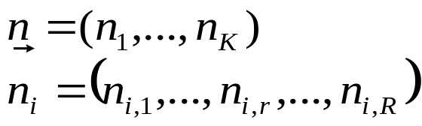

Product Form
Network state:
BCM theorem: condition for product form solution:
no. of class r customers at device i.

Slide 50
The following notation is used for the multiclass models presented here :
K: number of devices or service centers of the model
R: number of classes of customers
M_{r}: number of terminals of class r
Z_{r}: think time of class r
N_{r}: class r population
λ_{r}: arrival rate of class r
S_{i,r}: average service time of class r customers at device i
V_{i,r}: average visit ratio of class r customers at device i
D_{i,r}: average service demand of class r customers at device i;
  D_{i,r} = V_{i,r} S_{i,r}.

Slide 51
R_{i,r}: average response time per visit of class r customers at device i
R'_{i,r}: average residence time of class r customers at device i (the total time spent by class r customers at device i over all visits to the device);
ñ_{i,r}: average number of class r customers at device i
ñi: average number of customers at device i
X_{i,r}: class r throughput at device i
X_{o,r}: class r system throughput
R_{r}: class r response time

Slide 52
Chapter 13-Outlines
13.1 Introduction
13.2 The Need for Multiple-Class Models
13.3 Simple Two-Class Model
13.4 Notation and Assumptions
13.5 Closed Models
13.6 Open Models
13.7 Mixed Models
13.8 Concluding Remarks
13.9 Exercises

Slide 53


Load Intensity
The load intensity of a multiclass model with R classes and K devices is represented by the vector , where N_{r} indicates the number of class r customers in the system.
The goal of multiclass algorithms is to calculate the performance measures of the network as a function of .

Slide 54
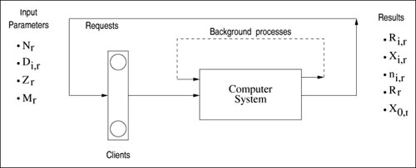
Figure 13.2 Multiple class closed model
The two types of processing that are usually modeled as closed classes are background batch jobs and interactive jobs. The key feature is that the total load placed by these classes on a system is constant as depicted in Figure 13.2.
Figure 13.2 Multiple class closed model

Slide 55
Types of Loads
The number of background processes in the system is constant (batch class).
In an interactive system, each customer (transaction, process, user, job) alternates between thinking and waiting (interactive class).
  There exists M_{r} requests in the system, where each request cycles between spending R_{r} units of time executing and Z_{r} time units thinking.
A closed model is a combination of batch and interactive classes.

Slide 56
Class Descriptor Parameters
The closed system analysis begins with
  the load intensity vector and
  the class descriptor parameters
  (D_{i,r}, M_{r}, Z_{r}).
The analysis computes, for each class,:
  the throughputs,
  response times, and
  queue lengths.

Slide 57
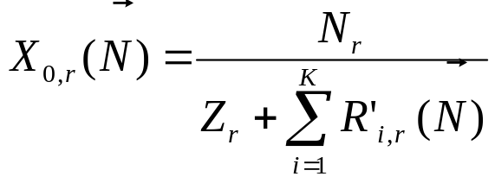
Throughput
The MVA-based solution of a multiclass system relies on 3 basic equations applied to each class.
  Equation 13.5.1 :
Equation (13.5.1) is obtained by applying Little's Law separately to each class of customers.
If r is a batch class, then Z_{r} is zero.

Slide 58
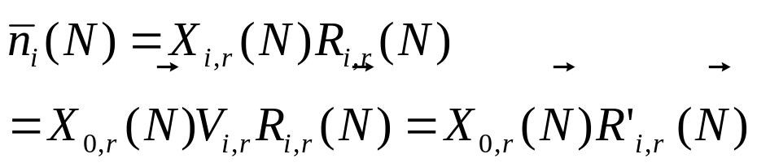
Customer Number
Applying Little's Law and the Forced Flow Law to each service center yields Eq. (13.5.2).
Equation 13.5.2 :

Slide 59

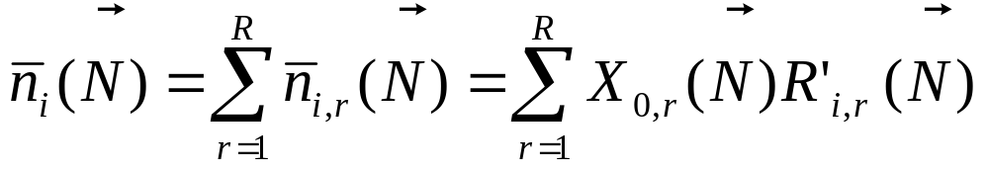
Total Number
Summing up customers of all classes at device i gives the total number of customers at that device,
  Equation 13.5.3 :

Slide 60
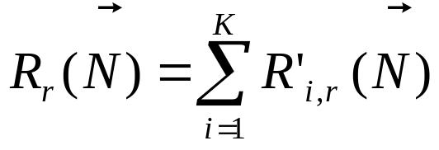
Residence Time
The residence time corresponds to the total time a class r customer spends at server i.
It includes the service demand (D_{i,r}) plus the total waiting time at the device.
The average response time of class r customers can then be written as :

Slide 61
Response Time
The mean response time of a class r customer at device i equals its own mean service time at that device plus the time to complete the mean backlog seen upon its arrival (the average number of customers seen upon arrival multiplied by each customer's mean service time).

Slide 62
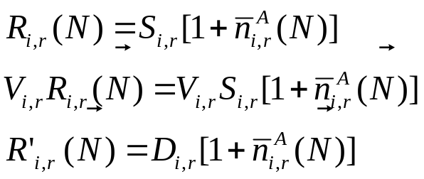

Response Time’
Therefore,
Equation 13.5.4 :
where is the average queue length at device i seen by an arriving class r customer.
As seen in Eq. (13.5.4), the average residence time is a function of the service demand and not of the individual values of the service times and visit ratios.

Slide 63


Delay Server
In the case of a delay server, it follows directly by definition that the backlog is zero ,
which makes .

Slide 64

Service Time Decomposition
When the scheduling discipline of center i is PS or LCFS-PR, the expression can be viewed as an inflation factor of the service demand due to the congestion by other customers.
For FCFS service centers, Eq. (13.5.4) represents
  the customer's own service demand
  +
  the time to complete the service of all customers in front of it.

Slide 65
Scheduling Categories
For practical purposes, scheduling disciplines can be grouped into two categories:
  Delay and
  Queuing.
Queuing encompasses load-independent servers with the following disciplines:
  PS,
  LCFS-PR, and
  FCFS.

Slide 66


Solution: Exact, Approximate
Having as a starting point the fact that the queue length is zero when there are no customers in the network, ,
Eqs. (13.5.1), (13.5.2), and (13.5.4) can be used iteratively to calculate the performance measures of the model.
Multi-class model solution techniques are grouped into either exact or approximate solutions, depending on the way the backlog seen upon arrival [ ] is calculated.

Slide 67
Solution to Problem
However, there is a minor problem;
  no expression for has yet been given.
Given that expression it would be easy to solve a multiclass model.
Multi-class model solution techniques are grouped into either
  exact or
  approximate,
depending on the way the backlog seen upon arrival [i.e., ] is calculated.

Slide 68


Exact Solution Algorithm
Arrival theorem [16, 17] states that
  a class r customer arriving at service center i in a system with population sees the distribution of the number of customers in that center as being equal to the steady-state distribution for a network with population .

Slide 69




System Equilibrium
The vector consists of a 1 in the r_{th} position and zeros in the rest of the vector [(0, 0, ..., 1, ..., 0)], namely:
In other words, the arriving customer sees the system in equilibrium with itself removed.
In the transaction system example with population , a query transaction that arrives at the CPU sees a queuing distribution equal to that of the system with population
.

Slide 70

Arrival Equation
From the arrival theorem it follows that :
Equation 13.5.5 :

Slide 71
The Equations
Combining Eqs.
  (13.5.1),
  (13.5.2),
  (13.5.3),
  (13.5.4), and
  (13.5.5),
  the algorithm for the exact solution of closed multiclass models is described in Figure 13.3.

Slide 72
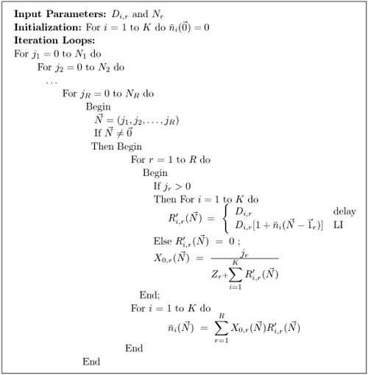
Figure 13.3

Slide 73
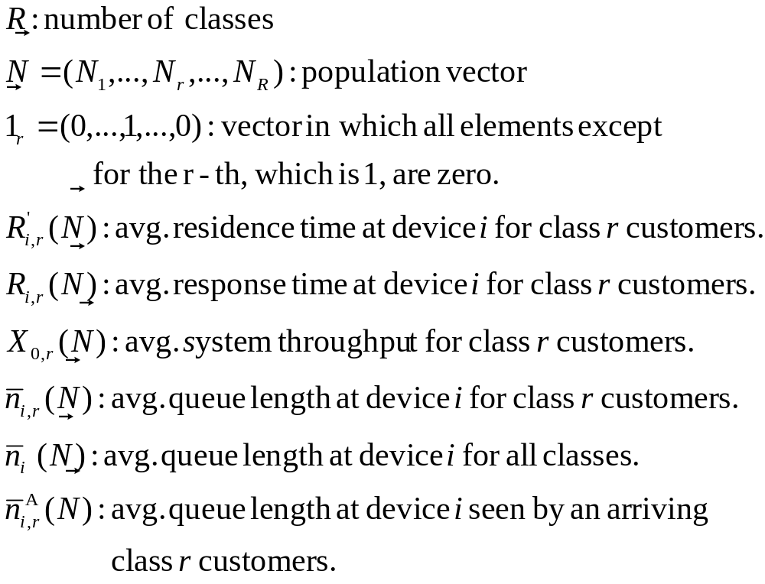
Notation for Closed Multiclass QNs
Summery of Closed
© 2004 D. A. Menascé. All Rights Reserved.

Slide 74
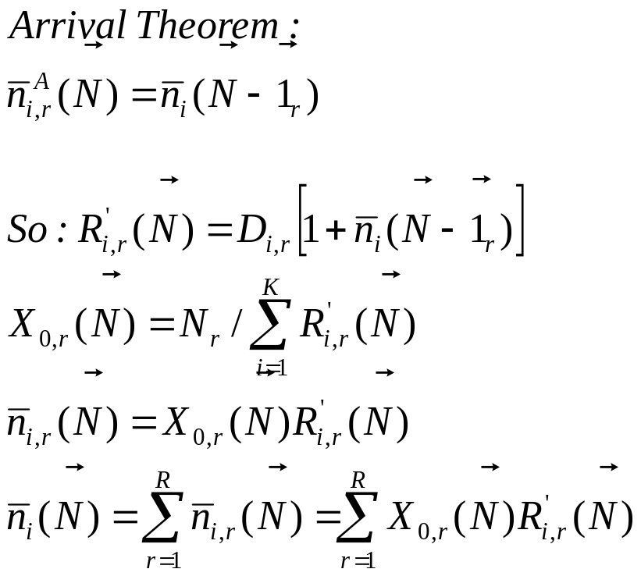
MVA Formulas for Multiclass QNs
Summery of Closed
© 2004 D. A. Menascé. All Rights Reserved.

Slide 75
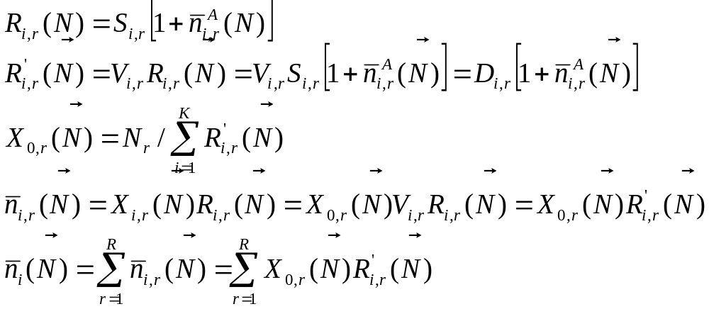
MVA Formulas for Multiclass QNs
Summery of Closed
© 2004 D. A. Menascé. All Rights Reserved.

Slide 76
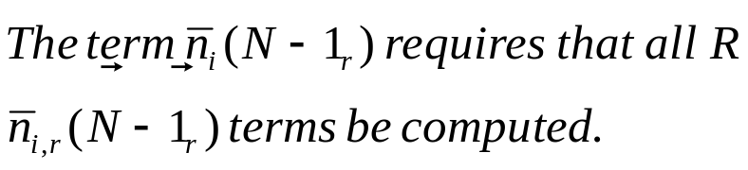
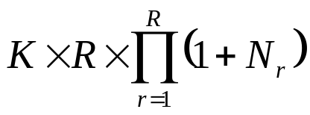
MVA Formulas for Multiclass QNs
Summery of Closed
(1, 3)
(0, 3)
(1, 2)
(0, 2)
(1, 1)
Computational complexity:
(0, 1)
(1, 0)
(0, 0)

Slide 77
Closed Models: Case Study
The algorithm of Figure 13.3 can be used to obtain the performance measures for each class.
By first applying the exact algorithm to the model described in Table 13.1 [to calculate the results for the population of one update and three query transactions, ].

Slide 78
Initialization
From the arrival theorem, to calculate the residence time at the devices for population (1,3), the device queue lengths are required for populations (0, 3) and (1, 2).
By continually removing one customer from each class, eventually the performance measures for population (0, 0) are calculated, which is the starting point of the algorithm.

Slide 79
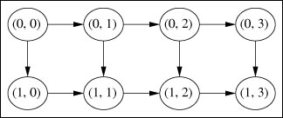
Precedence Relation
Figure 13.4 shows the precedence relationships required to calculate the results of a system with population (1, 3) using exact MVA.
Figure 13.4. Sequence of calculations of MVA.

Slide 80


Algorithm for Baseline
Table 13.3 shows for each population of the sequence of Figure 13.4 the results calculated by the exact MVA algorithm for the baseline model of the transaction system example.
The interaction among the multiple classes is explicitly represented by the term in the equation .
The average number of customers at device i reflects the contention for shared resources among the distinct classes of the workload.

Slide 81
Table 13.3. Step-by-Step Results of the Two-Class Model Solution
Class | Variable | Population (Update, Query)
 |  | (0,0) | (0,1) | (0,2) | (0,3) | (1,0) | (1,1) | (1,2) | (1,3)
Query | R'1,q R'2,q R'3,q | - - - | 0.105 0.180 0.000 | 0.144 0.294 0.000 | 0.174 0.422 0.000 | - - - | 0.141 0.259 0.000 | 0.177 0.388 0.000 | 0.204 0.529 0.000
 | X0,q | - | 3.509 | 4.566 | 5.034 | - | 2.500 | 3.540 | 4.093
 | n1,q n2,q n3,q | 0 0 0 | 0.368 0.632 0.000 | 0.658 1.342 0.000 | 0.876 2.124 0.000 | - - - | 0.352 0.648 0.000 | 0.627 1.373 0.000 | 0.835 2.165 0.000
Update | R'1,u R'2,u R'3,u | - - - | - - - | - - - | - - - | 0.375 0.480 0.240 | 0.513 0.783 0.240 | 0.622 1.124 0.240 | 0.704 1.500 0.240
 | X0,u | - | - | - | - | 0.913 | 0.651 | 0.504 | 0.409
 | n1,u n1,u n1,u | 0 0 0 | - - - | - - - | - - - | 0.343 0.438 0.219 | 0.334 0.510 0.156 | 0.313 0.566 0.121 | 0.288 0.614 0.098

Slide 82
Comparison
From Table 13.3 ,the calculated throughputs for the query and update classes match the measurement results of Table 13.1.
Either using Little's Law, or summing the average device residence times, the average response times are obtained for the two classes:
  0.733 sec for queries and
  2.444 sec for updates.

Slide 83
Predictive Model
To construct a predictive model, the parameters of the predicted system need to be specified.
Consider the two questions posed in Section 13.3.

Slide 84
Throughput
1. What is the predicted increase in the throughput of query transactions if the load of the update class is moved to off-peak hours?
Answer: Since the update class will be removed, the number of transaction in the system will remain 4 and the system will have a population of 4 query transactions. Solving a single-class model with 4 queries, a throughput of 5.275 tps is obtained, that indicates that the removal of the update class increases throughput by 28.87%.

Slide 85
Utilization-Q
Realizing that
  disk 1 is the bottleneck (the device with the highest utilization) and
  disk 2 is lightly loaded,
  What is the predicted response time if the total I/O load of query transactions is moved to disk 2?

Slide 86
Utilization Answer
Answer: To construct the predictive model, we shift the value of D_{2,q} to D_{3,q}, to indicate that the I/O load of query transactions will be moved from disk1 to disk2. With the new parameters, the model is resolved to give the following results: X_{0,q} = 4.335 tps, X_{0,u} = 0.517 tps,R_{q} = 0.692 sec, and R_{u} = 1.934 sec. These results indicate a reduction of 5.6% in the average response time of queries and 20.9% in the mean response time of update transactions.

Slide 87
Utilization Answer’
Why does the proposed modification favor the update class?
First, consider the system performance measures obtained by the baseline and predictive models, respectively.

Slide 88
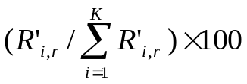
Utilization Answer’’
From Table 13.4, the proposed modification changes the bottleneck from disk 1 to disk 2 and, at the same time, provides a better balance of disk utilization. Let the residence time percentage be the time a transaction spends at device i, expressed as a percentage of the average response time for the transaction [ ].
Model | Class | Utilization (%)
 |  | Processor | Disk 1 | Disk 2
Baseline | Query Update Total | 42.98 15.33 58.31 | 73.67 19.63 93.3 | 0 9.81 9.81
Modified | Query Update Total | 45.51 19.38 64.89 | 0 24.81 24.81 | 78.03 12.40 90.43

Slide 89
Residence Time
From Table 13.5 note that in the baseline model, query transactions spend 72.2% of their average response time at the bottleneck device, whereas update transactions spend 61.4%.
Table 13.5. Residence Time Percentage
Model | Class | Residence Time (%)
 |  | Processor | Disk 1 | Disk 2
Baseline | Query Update | 27.8 28.8 | 72.2 61.4 | 0 9.8
Modified | Query Update | 31.5 36.4 | 0 24.8 | 68.5 38.8

Slide 90
Residence Time’
When the I/O load of query transactions is moved to disk 2, it becomes the bottleneck.
Update transactions benefit more from the modification because they get better disk utilization balance.
To confirm this, the results in Table 13.5 show that update transactions spend 24.8% and 38.8% of their time at disk 1 and disk 2, respectively.
Moreover, disk 1 has no contention, since it is dedicated to the update transaction class.
In contrast, query transactions concentrate their I/O on Disk 2, which is also used by updates.

Slide 91
Final Word
Looking at Figure 13.4, note that to compute the results of the model with population (1, 2), the results of populations (1, 1) and (0, 2) are needed.
Each of these populations requires, as input, queue lengths from two related populations.
In the general case, when a system has R classes, each calculation of metrics for a given population demands inputs from R other populations.
the computational complexity of MVA algorithms grows exponentially with the number of classes.

Slide 92
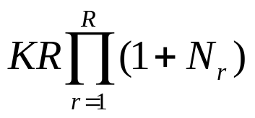
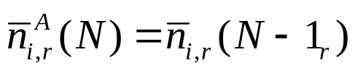
Approximate Solution Algorithms
The number of multiplications and the number of additions required to solve a multiclass model is proportional to
Equation 13.5.6 :
Modeling distributed systems often involve large queuing networks.
The source of the large number of operations required to compute the exact MVA algorithm is the recursion expressed in the equation
Equation 13.5.7

Slide 93

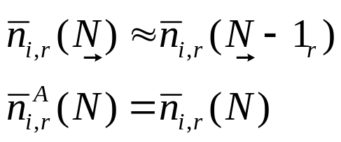
Approximation 1
With the goal of reducing the time and space complexity of the MVA algorithm, several approximations have been proposed [18]. These algorithms reduce the complexity by substituting approximations for that are not recursive.
A very simple approximation, due to Bard [4], is as follows:
Equation 13.5.8 :
This approximation is attractive when the number of customers becomes large.

Slide 94
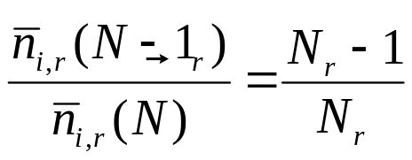
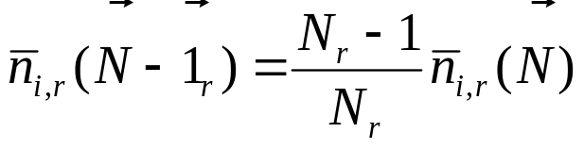
Schweitzer Approximation
The most commonly used approximation is one proposed by Schweitzer [19] for BCMP models.
It is based on the assumption that the number of class r customers at each service center increases proportionally to the number of class r customers in the network. From this observation it follows that
Equation 13.5.9 :
Equation 13.5.10 :

Slide 95

Schweitzer Approximation’
Equation (13.5.10) is the basis of an iterative method for calculating performance measures of a closed model, described by the algorithm of Figure 13.5.
The basic idea is to substitute estimates for queue lengths [ ] into Eq. (13.5.10) and use the MVA equations to compute the next estimates for .

Slide 96



Schweitzer Approximation’’
Iteration starts with an estimate which assumes that class r customers are equally distributed among the K devices of the network.
Iteration stops when successive values of are sufficiently close
[ , where is a tolerance bound].
Note that in the algorithm, the notation K_{r} is used to indicate the number of devices for which D_{i,r} > 0.

Slide 97
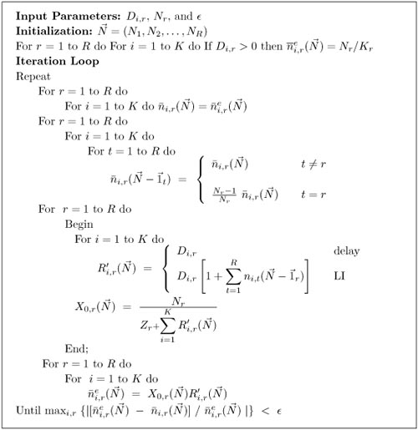
Figure 13.5. Approximate MVA algorithm for multiple classes

Slide 98
Computational Cost
The computational cost of solving the iterative method is proportional to the product (K x R) per iteration and typical errors are quite small
(Around 2% for relatively small populations and less than 1% for relatively large populations).

Slide 99
Benefit and Drawback
The iterative solution of the model of the hypothetical distributed system discussed in Section 13.5.1 would require a number of operations proportional to (5 x 20 = 100), as opposed to 104 million operations for the exact solution.
Although approximate methods provide a cheaper solution for product-form multiclass models, they have a serious drawback.

Slide 100
Drawback
The commonly used approximate methods for solving multiclass models do not provide bounds on the errors introduced by the approximations.
Therefore, to assess the approximation's reliability, one has to validate the results against the exact MVA results, which is impossible in large systems.

Slide 101
Note
To exemplify the accuracy of Schweitzer's approximation, compare the exact results of the transaction system example with those calculated by the iterative process, given that the maximum tolerance for the absolute difference between successive values of the queue lengths is 0.01.

Slide 102
Example
Table 13.6 shows the throughput and response time computed under both methods. As seen, the maximum observed relative error is 2.25%.
Table 13.6. Exact and Approximate Results
 | Throughput |  | Response Time
Method | Query | Update | Query | Update
Exact MVA Approximate Relative error (|%|) | 4.093 4.001 2.25 | 0.409 0.407 0.49 | 0.733 0.749 0.22 | 2.445 2.456 0.45

Slide 103
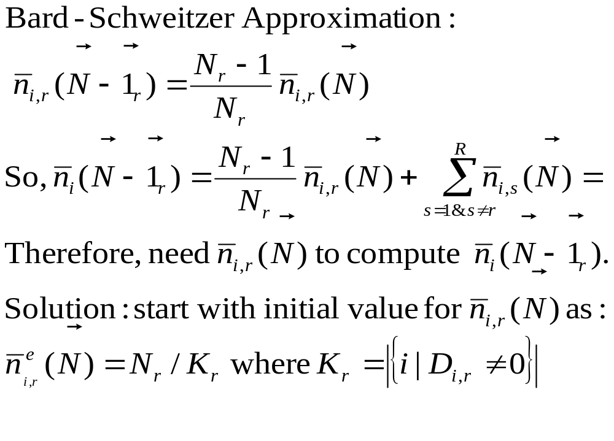
Approximate MVA for Multiclass Closed QNs
Summery of Closed

Slide 104
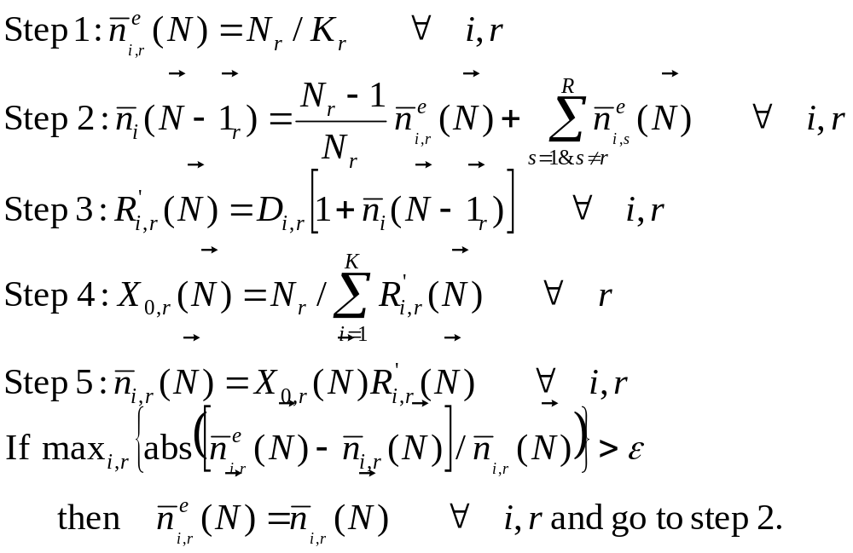
Approximate MVA for Multiclass QNs
Summery of Closed

Slide 105
Example 13.2.
Consider a closed model that represents a packet switching store and forward communication network with flow control mechanism [15].
Consider that each virtual channel is represented by one class. Thus, the number of customers in each class represents the window size (the maximum number of messages allowed on the virtual channel).

Slide 106


Example 13.2’
To keep the example simple, assume that the devices of the model represent the sink node, the source node, and the virtual channel. All devices are assumed to meet the BCMP requirements.
The model to be solved has the following parameters:
2 classes (2 virtual channels),
N₁ = 20, N₂ = 25 (window sizes),
= (0.0030, 0.0009,0.0123), and
= (0.0035, 0.0215,0.0011)

Slide 107
Table 13.7. Approximate MVA Computation
Table 13.7 shows the iterations for solving this model. 0.01 is the maximum difference between successive values of N_{i,r}. Within 9 iterations we obtain results whose maximum error equals to 1.59% .
 | Class 1 |  |  |  | Class 2
 | Queue Length |  |  |  | Queue Length
 | Channel | Source | Sink | TPUT | Channel | Source | Sink | TPUT
1 2 3 4 5 6 7 8 9 Exact Error(%) | 8.333 3.704 1.914 0.995 0.610 0.459 0.401 0.379 0.371 0.377 1.59 | 8.333 1.111 1.652 1.817 1.843 1.842 1.839 1.837 1.837 1.863 1.39 | 8.333 15.185 16.433 17.189 17.545 17.697 17.758 17.782 17.791 17.760 0.17 | 78.80 81.07 79.73 78.26 77.43 77.05 76.90 76.83 76.83 77.43 0.77 | 6.667 3.352 1.341 0.655 0.399 0.301 0.264 0.249 0.244 0.246 0.81 | 6.667 20.593 22.745 23.448 23.688 23.775 23.806 23.818 23.822 23.813 0.03 | 6.667 1.054 0.915 0.897 0.911 0.923 0.929 0.932 0.933 0.942 0.98 | 61.13 48.34 44.53 43.50 43.22 43.14 43.11 43.10 43.10 43.27 0.39

Slide 108
Chapter 13-Outlines
13.1 Introduction
13.2 The Need for Multiple-Class Models
13.3 Simple Two-Class Model
13.4 Notation and Assumptions
13.5 Closed Models
13.6 Open Models
13.7 Mixed Models
13.8 Concluding Remarks
13.9 Exercises

Slide 109
Open Models-Example
Consider a LAN, with a collection of clients and servers.
A file server is a key component of this kind of environment, that provide file services for the client processes on the network.
It is composed of processors, memory, and a disk subsystem.
The workload of a file server is a series of file service requests ( read, write, create, and remove) , which arrive from the workstations via the LAN.

Slide 110
Loads
Requests arrive to the server.
A typical request enters the server, possibly queues up while waiting for some resource, obtains service from it, and exits the server.
The number of requests being handled concurrently by the server varies over time depending on factors such as
  the request arrival rate,
  the file system capacity,
  the available memory, and
  the processor speed.

Slide 111
Class of Problem
A file has the key characteristic of open systems:
  the variation of the number of customers over time.
In practice, the number of customers (transactions, processes, requests) varies dynamically.
An open class is able to represent this variation because it has a potentially unlimited number of customers.

Slide 112

Load Intensity
Chapter 10 introduces and analyzes the birth-death system, which gives the underlying theory for single-class open model.
This analysis is extended here to multiclass models.
The load intensity of a multiclass model with R open classes and K devices is represented by the vector
, where λ_{r} indicates the arrival rate of class r customers.

Slide 113



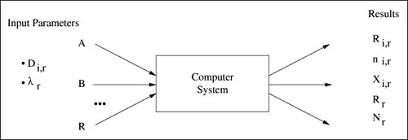
Figure 13.6
As illustrated in Figure 13.6, the goal of the analysis of multiclass open models is to determine, for each class, performance measures such as average response time, ,and queue lengths, , as a function of the load intensity, .
Figure 13.6. Multiple class open models.

Slide 114
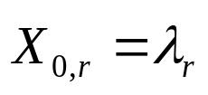
Throughput Equation
In steady state, the throughput of class r equals its arrival rate. Thus,
Equation 13.6.11:

Slide 115


Customer Number
The application of Little's Law to each device gives
Equation 13.6.12 :
where is the average class r customer response time per visit to device i.

Slide 116

Residence Time
The average residence time for the entire execution is R'_{i,r} = V_{i,r}R_{i,r}. Using the Forced Flow Law and Eq. (13.6.11), the throughput of class r is
Equation 13.6.13 :

Slide 117

Analysis of Multiclass Open Models
Using Eq. (13.6.13) in Eq. (13.6.12) the average queue length per device for each class becomes
Equation 13.6.14 :

Slide 118



Utilization
Combining the Utilization Law and the Forced Flow Law, the utilization of device i by class r customers can be written as
Equation 13.6.15:
Thus, to compute the average number of class r customers in service center i, is needed as a function of the input parameters ( and the service demands D_{i,r}'s) .

Slide 119




Response Time
The average time a class r customer spends at a device, from arrival until completion, can be written as :
Equation 13.6.16 :
where is the average queue length at device i seen by an arriving class r customer when the load on the system is for delay servers, .

Slide 120
Note
arrival theorem [17] :
states that in an open product-form queuing network, a class r arriving customer at device i sees the steady-state distribution of the device state, which is given by the queue length.

Slide 121

Arriving and Overall Distribution
In an open system, since there is an infinite customer population, removing oneself from the network has no effect.
Thus, the steady-state distribution seen by an arriving customer is equal to the overall steady-state distribution.
Thus,
Equation 13.6.17 :

Slide 122

Response Time Equation
From Eqs. (13.6.16) and (13.6.17), we get
Equation 13.6.18 :

Slide 123
Customer Equation
Substituting Eq. (13.6.18) into Eq. (13.6.14), yields
Equation 13.6.19 :

Slide 124


Notice that expression 1 + in Eq. (13.6.19) does not depend on class r. As a consequence, for any two classes r and s, we have
Equation 13.6.20 :
Using Eq. (13.6.20) and considering the fact that
,Eq. (13.6.19) can be rewritten as
Equation 13.6.21 :

Slide 125

Applying Little's Law to Eq. (13.6.21), the average residence time for class r customers at device i is
Equation 13.6.22 :
The interaction among the open classes of a multiclass model is represented by the term of Eq. (13.6.22), which corresponds to the total utilization of device i by all the classes in the model.
The analysis of a model with multiple open classes begins with the constraint 1 for all devices of the network and proceeds with the formulas summarized in Figure 13.7.

Slide 126
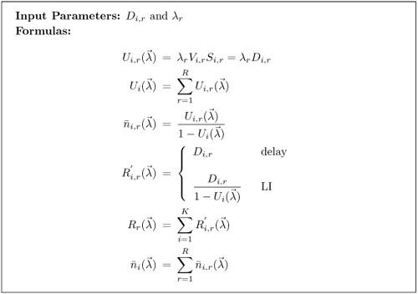
Figure 13.7. Formulas for models with multiple open classes.

Slide 127

From Eq. (13.6.15), the stability condition for an open model is
Equation 13.6.23 :
or
Equation 13.6.24 :

Slide 128
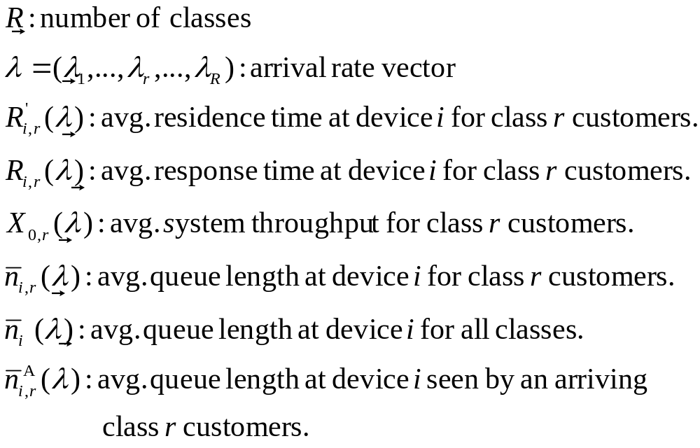
Notation for Open Multiclass QNs
Summery of Closed

Slide 129
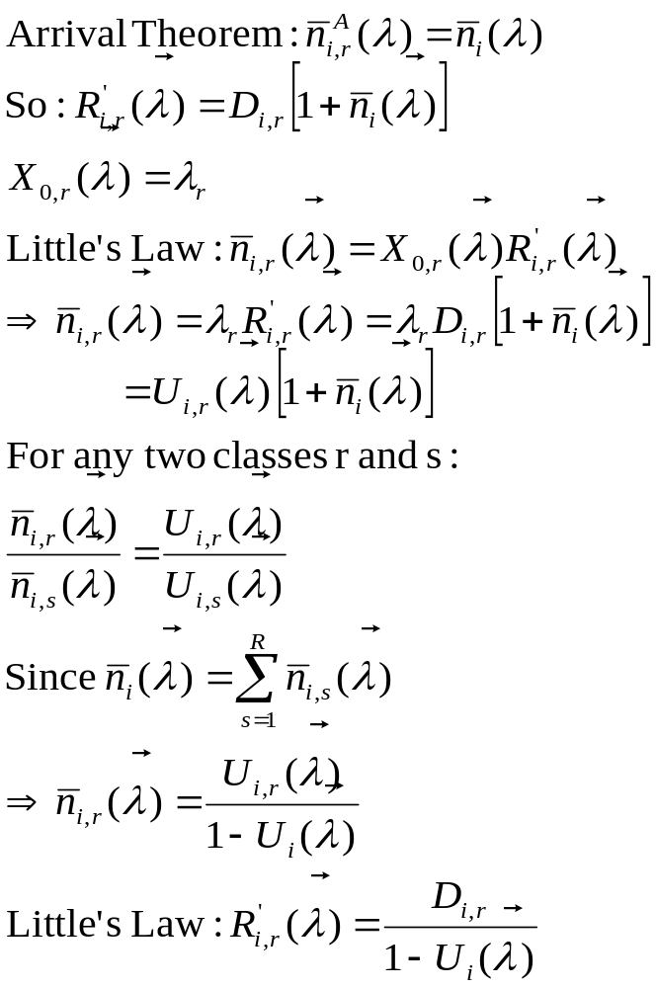
Formulas for Open Multiclass QNs
Summery of Closed

Slide 130
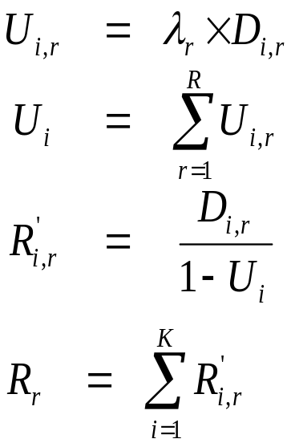
Formulas for Open QN Models
Summery of Closed

Slide 131
Open Models: Case Study
Consider a distributed environment made up of a number of client diskless computers connected via a high-speed LAN to a file server, composed of a single processor and one large disk.
The company is planning to double the number of client computers.
Because the system performance is critically dependent on the file server, management wishes to assess the impact of the expansion before it is implemented.
So, the first question to be answered is: What is the predicted performance of the file server if the number of diskless workstations doubles?

Slide 132
Open Models: Case Study
Following the modeling paradigm of Figure 10.1, the initial step is constructing the baseline model, which begins with the workload characterization.
The file server workload consists of three classes: read, write, and all others.
During a period of one hour, the file server was monitored and the following measurement data were collected : 18,000 reads, 7,200 writes, 3,600 file service requests other than reads and writes, processor utilization at 32%, and disk utilization at 48%.

Slide 133
Open Models: Case Study
The measurement data also provide resource utilization on a per-class basis, as shown in Table 13.8.
Using the measurement data and the operational relationship (D_{i,r} = U_{i,r}/X_{0,r}), each request is characterized in terms of its service demands.
Once D_{i,r} has been calculated, it is possible to compute V_{i,r} using the disk service time provided by the manufacturer.
For the processor, the parameter V_{proc,r} is calculated using the following expression that relates the visit ratio at the processor to the visit ratios at the I/O devices in a central server model :

Slide 134

Open Models: Case Study
Equation 13.6.25 :
where devices 2 through K are the I/O devices.
Table 13.8 summarizes the parameters that characterize the file server workload.
Table 13.8. File Server Workload Characteristics
 |  | Processor |  |  |  | Disk
Class | Arrival rate | U(%) | V | S | D(sec) | U(%) | V | S | D(sec)
Read Write Others | 5 req/sec 2 req/sec 1 req/sec | 9 18 5 | 3 6 5 | 0.006 0.015 0.100 | 0.018 0.090 0.050 | 20 20 8 | 2 5 4 | 0.020 0.020 0.020 | 0.040 0.100 0.080

Slide 135

Open Models: Case Study
The analyst in charge of the capacity planning project decided to construct a single-class model of the file server which is an open model where only the file service components (processor and disk) are directly represented.
Assume that the file server has enough memory so that no request queues for memory.
The single-class model equivalent to the three-class model is obtained by calculating the aggregate demands :

Slide 136
Open Models: Case Study
By solving the model, the following residence times are obtained:
= 0.04/(1 – 0.32) = 0.059 and
= 0.06/(1 – 0.48) = 0.115.
The sum gives an average request response time of 0.174 seconds.
To answer the "what if" question, it is necessary to change the baseline model to reflect the effects of doubling the number of workstations.
Assume that the new workstations will run the same group of applications and will generate file service requests that follow the current pattern of requests.

Slide 137
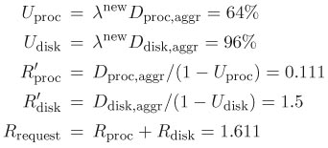
Thus, by increasing the number of workstations by 100%, the request arrival rate, likewise, is assumed to increase by 100%. Letting λ^{new} = 2 x 8 = 16, the model is re-solved to obtain the predicted measures.
Therefore, if the number of workstations were doubled, the file server disk would saturate and the average request response time would increase from 0.174 sec to 1.611 sec, an 825% increase!

Slide 138
Now consider some possible alternatives to support system expansion without impairing service levels. Each alternative is evaluated by considering the relative change in system performance from the baseline model.
Server caching scheme. The OS provides a cache for the server. So read and write cache hit ratios of 70% and 60%, respectively, can be achieved. To reduce the impact of unanticipated failures, every write operation to cache will also be applied to the disk. Thus, the server cache can then be modeled by reducing the visit ratio of read requests
[ = (1 – hit ratio)V_{disk,read}].

Slide 139
To understand the impact of the server cache on the performance, a three-class model is solved using the predicted arrival rate and letting
= (1 – 0.7) x 0.04 = 0.012.
Client caching scheme. When a read is issued at the workstation, the data read are stored in a local client cache [10]. This reduces significantly the number of requests that go to the server. For the sake of reliability, a write operation always goes to the disk in the server after updating the client cache. This client cache in the workstations is modeled by reducing the arrival rate of read requests.

Slide 140
Thus, = (1 – client hit ratio)λ_{read}. Assuming a client hit ratio of 70%, the new value for the parameter that represents the change is given by
= (1 – 0.7) x 10 = 3.
Upgrade in disk subsystem. The third alternative is upgrading the storage subsystem and installing a second disk unit in the file server. This change is represented in the model by adding a third service center. The original disk service demand will be equally split between the two disks
(i.e., ).

Slide 141
For each alternative, a three-class model is evaluated according to the formulas of Figure 13.7.
Table 13.9 summarizes the performance measures obtained for the three alternatives. To obtain a rank of the alternatives in terms of performance, aggregate response time is first calculated for each alternative, which is the average of the individual classes weighted by the class throughput.
Table 13.10 displays the aggregate response times as well as the relative change in the response time from the baseline model. The pure expansion refers to the alternative that just increases the number of workstations. All alternatives assume that the number of workstations will be doubled.

Slide 142
Table 13.9. Results of an Open Three-Class Model
 | Processor |  | Disk |  | Extra Disk
Alternative | U(%) | R’(sec) | U(%) | R’(sec) | U(%) | R’(sec)
Server cache Read Write Other | 18 36 10 | 0.050 0.250 0.139 | 12 40 16 | 0.038 0.313 0.250 | - - - | - - -
Client cache Read Write Other | 5.4 36 10 | 0.037 0.185 0.103 | 12 40 16 | 0.125 0.313 0.250 | - - - | - - -
Disk Upgrade Read Write Other | 18 36 10 | 0.050 0.250 0.139 | 20 20 8 | 0.038 0.096 0.077 | 20 20 8 | 0.038 0.096 0.077

Slide 143
From the file server perspective, the best alternative is upgrading the disk subsystem, because it diminishes the demand on the original disk.The client cache,may be the best alternative from the system viewpoint. The key issue in this alternative is the reduction in the number of times that a user process goes to the file server.
Table 13.10. Performance of the Alternatives
Alternative Baseline | Response Time (sec) 0.174 | Variation (%) -
Pure expansion Server cache Client cache Disk upgrade | 1.611 0.244 0.354 0.227 | 825 40 103 30

Slide 144
Chapter 13-Outlines
13.1 Introduction
13.2 The Need for Multiple-Class Models
13.3 Simple Two-Class Model
13.4 Notation and Assumptions
13.5 Closed Models
13.6 Open Models
13.7 Mixed Models
13.8 Concluding Remarks
13.9 Exercises

Slide 145
Mixed Models
A mixed model with R classes of customers has C closed classes and O open classes, where R = C + O.
A mixed model can be viewed as a combination of two separate submodels, a closed model and an open model, that happen to share the common resources of a computer system, as depicted in Figure 13.8.
The load intensity of a mixed queuing network model is defined by a pair of vectors ,
where specifies the customer populations of the closed submodel and
represents the arrival rates of the open submodel.

Slide 146
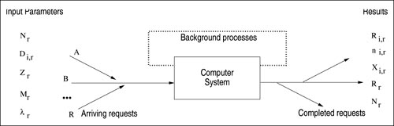
Figure 13.8. Multiclass mixed models.
The basic approach to solve a mixed multiclass model is to solve their submodels independently, but with adjusted service demands to represent the impact on each other.

Slide 147
Because the device utilizations do not depend on the closed submodel, the open submodel is solved first and the device utilizations due to the open classes is obtained.
The effect of contention at server due to customers of different submodels is represented by elongating the service demands for the closed submodel.
To elongate the service demands appropriately, they are multiplied by a factor that is proportional to the inverse of the idle time remaining from the open submodel [1/(1 – U_{i,open})] [1]).

Slide 148
The closed submodel with the elongated service demands is then solved using the MVA algorithm.
Response times of the open submodels are affected by the closed submodel.
To account for this interference, the average queue lengths of closed customers is used in the calculation of response times of open customers ( is included in the number of customers seen by an arriving open customer).
See the mixed class algorithm in Figure 13.9.

Slide 149
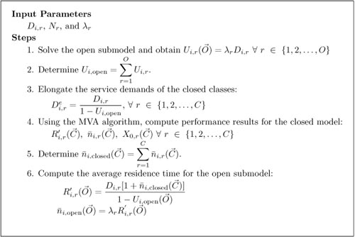
Figure 13.9. Algorithm for mixed multiclass models.

Slide 150
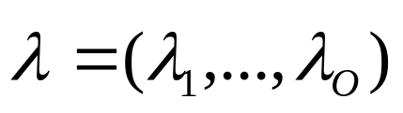
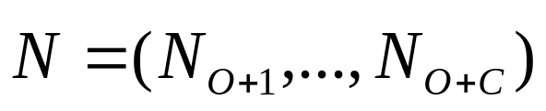
Mixed Class Models
Classes 1, …, O are open and classes O+1, O+2, …, O+C are closed.
The O open classes are characterized by the vector of arrival rates
The C closed classes are characterized by the population vector

Slide 151
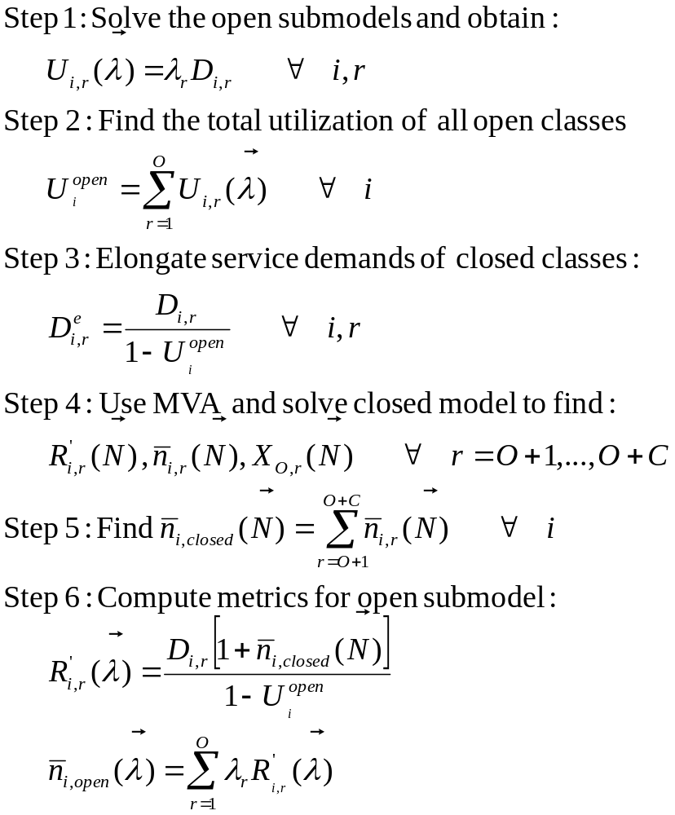
Solution of Mixed Class Models

Slide 152
Example 13.3.
Reconsider the simple two-class model described in Section 13.3. Suppose now that the way of viewing the system has been changed by deciding to represent the query class as a transaction class, with arrival rate equal to 4.09 tps. Table 13.11 shows the input parameters of the mixed model.
Table 13.11. Measurement Data for the Transaction Processing System
 |  | Service Demand
Class | Type | Processor | Disk 1 | Disk 2 | Transactions in the System | Arrival Rate
Query Update | Open Closed | 0.105 0.375 | 0.180 0.480 | 0 0.240 | - 1 | 4.09 -

Slide 153

Example 13.3.
By following the algorithm of Figure 13.9, the first step is to calculate the utilization due to the open class with λ₁ = 4.09 tps.
Open submodel
Using the utilizations due to the open class, the adjusted service demands are calculated for the closed submodel. By applying the MVA algorithm to solve the closed submodel with N₁ = (1), the following are obtained:

Slide 154
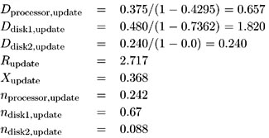
Closed submodel
To compute the average response time of the open submodel, the queue lengths of the closed submodel are used to reflect the contention in the servers.

Slide 155
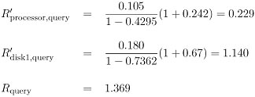
Open submodel
Mixed queuing networks can also be used for predicting purposes. For example, what is the performance of the query transactions if the load of update jobs is doubled? It is only necessary to change the number of update transactions in the system from 1 to 2 and re-solve the model. The new value for the response time of query transactions is 1.947, which corresponds to a 42% increase.

Slide 156
Chapter 13-Outlines
13.1 Introduction
13.2 The Need for Multiple-Class Models
13.3 Simple Two-Class Model
13.4 Notation and Assumptions
13.5 Closed Models
13.6 Open Models
13.7 Mixed Models
13.8 Concluding Remarks
13.9 Exercises

Slide 157
Concluding Remarks
In this chapter queuing network models with multiple classes have been analyzed. These models are appropriate for describing workloads of actual systems. Usually, "what if" questions that appear in capacity planning are associated with individual classes of customers. Multi-class models provide performance results for individual class analysis. The discussion has concentrated on techniques for solving a special category of multiclass models, known as product-form, separable, or BCMP networks. The techniques are grouped into sections. One section refers to the exact and approximate solutions of closed models, where the load intensity is assumed to be constant. Another section shows how to solve open multiclass models, where external arrivals and departures of customers are allowed. Mixed models with both closed and open classes are solved by a combination of the two previous techniques.

Slide 158
Concluding Remarks
This chapter focused on queuing models with load-independent (LI) devices. The algorithms for solving open multiclass QNs are in the MS Excel OpenQN.XLS workbook and the approximate multiclass MVA solution technique is implemented in the MS Excel ClosedQN.XLS workbook. Some computer systems may have components that behave as load-dependent devices (LD), at which the service rate varies with the number of customers present in its queue. The next chapter presents techniques to analyze the performance of queuing models with load-dependent devices.

